Slide 1
Global Warming &
Climate Change

Slide 2
What is Global Warming?
Global warming is the process wherein the average temperature of the Earth's near surface air increases, owing largely to various anthropogenic activities. Though there are some natural causes for this rise in temperature, they stand to be insignificant when compared to the anthropogenic causes.
Causes of Global Warming
The causes of global warming are broadly divided into two categories - natural causes and anthropogenic (man-made) causes.

Slide 4
Causes of Global Warming
Natural Causes
Natural causes of global warming include the release of methane gas from arctic tundra and wetlands, climate change, volcanoes etc. In case of volcanoes, when a volcano erupts, tons of ash is let out into the atmosphere.
The natural contribution to global warming is insignificant when compared to human contribution for this hazard.
Anthropogenic Causes
Anthropogenic causes for global warming are those which are caused due to human activities. The most prominent cause being man-made pollution. A large part of this pollution can be attributed to the burning of fossil fuels.

Slide 5
Anthropogenic Cause……...
Humans breathe out carbon dioxide, and with an increasing population, the amount of carbon dioxide humans breathe out also increases and leads to global warming.
Even agriculture contributes to global warming, owing to the extensive use of fertilizers, and the dung produced by cattle which is another prominent source of methane.

Slide 6
THE GREENHOUSE GASES
Carbon Dioxide is the most significant greenhouse gas released by human activities, mostly through the burning of fossil fuels. It is the main contributor to climate change. | Methane is produced when vegetation is burned, digested or rotted with no oxygen present. Garbage dumps, rice paddies, and grazing cows and other livestock release lots of methane. | You can find nitrous oxide naturally in the environment but human activities are increasing the amounts. Nitrous oxide is released when chemical fertilizers and manure are used in agriculture. | Halocarbons are a family of chemicals that include CFCs (which also damage the ozone layer), and other human-made chemicals that contain chlorine and fluorine.

Slide 7
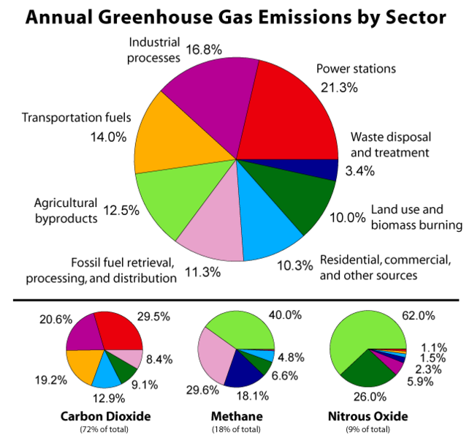

Slide 8
Green House Gases (GHGs)
One of the first things scientists learned is that there are several greenhouse gases responsible for warming, and humans emit them in a variety of ways. Most come from the combustion of fossil fuels in cars, factories and electricity production.
The gas responsible for the most warming is CO₂. Other contributors include methane releases from landfills and agriculture (especially from the digestive systems of grazing animals), nitrous oxide from fertilizers, CFCs, and the loss of forests that would otherwise store CO₂.
Different greenhouse gases have very different heat-trapping abilities. Some of them can even trap more heat than CO₂. A molecule of methane produces more than 20 times the warming of a molecule of CO₂. Nitrous oxide is 300 times more powerful than CO₂.

Slide 9
Green House Gases (GHGs)
Scientists now realise that the proportion of these gases has increased significantly over a few hundred years. The real increase began around the time of the Industrial Revolution. This is when we began to burn fossil fuels (coal) in large quantities to power our steam engines for industry, generate electricity, and heat our homes.
Carbon dioxide, nitrous oxide and methane have all increased significantly since the 1800s. Today the use of fossil fuel for power and electricity is thousands of times more than what it was in the 1800s.

Slide 10
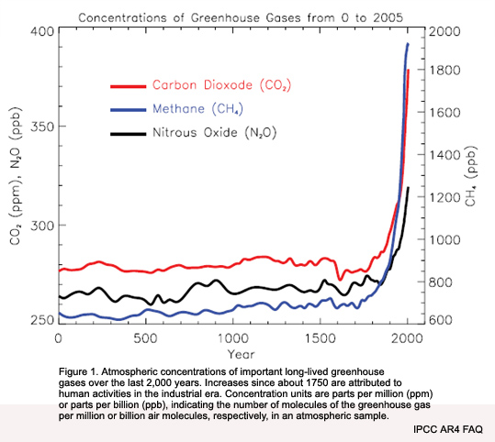

Slide 11
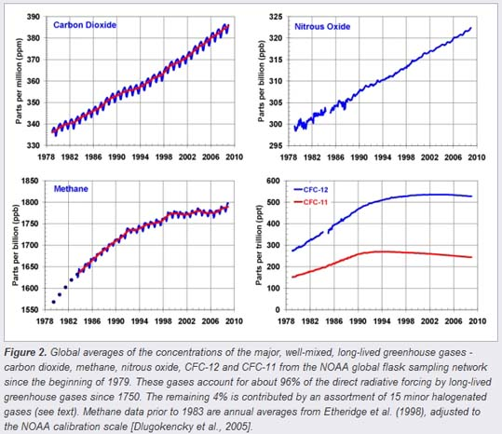
Greenhouse Gas Increasing

Slide 12
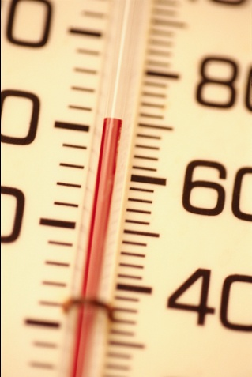
Difference
GLOBAL WARMING
is the increase of the Earth’s average surface temperature due to a build-up of greenhouse gases in the atmosphere.
CLIMATE CHANGE
is a broader term that refers to long-term changes in climate, including average temperature and precipitation.

Slide 13
What’s the proof that global warming is taking place?

Slide 14
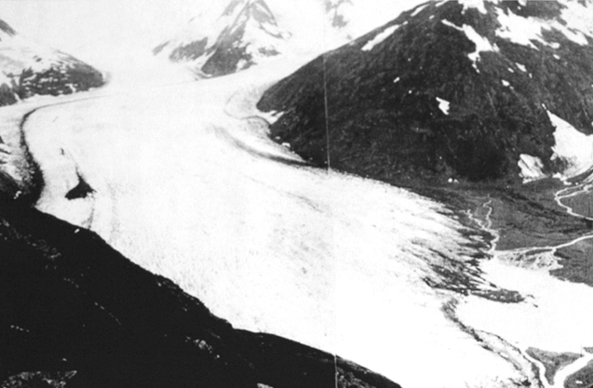
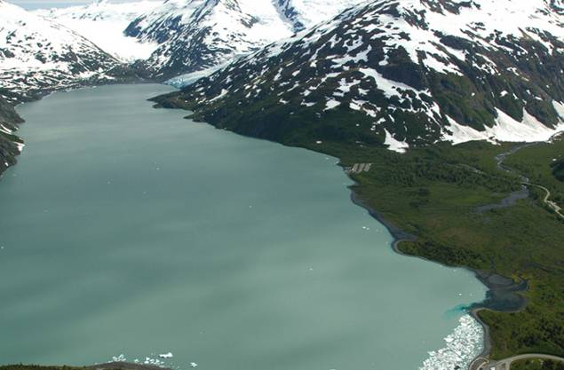
Portage Glacier
Alaska
1914
2004
Photos: NOAA Photo Collection and Gary Braasch – WorldViewOfGlobalWarming.org

Slide 15
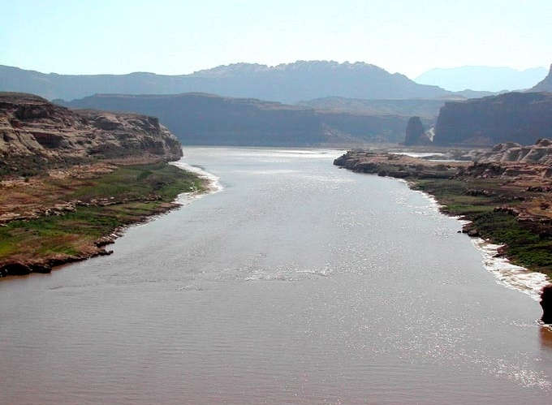
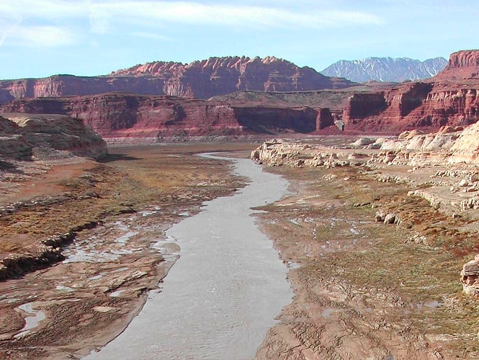
Colorado River
Arizona
June 2002
Dec 2003

Slide 16
The Facts of Climate Change
Climate change is strongly supported by hard science.
Global-average surface temperature is increased by about 0.6 ºC over 20th century;
1990s warmest decade and 1998 warmest year in last 1000 years in Northern Hemisphere;
Over last 50 years night-time minimum temperatures increased by about 0.2 ºC per decade;
10% reduction in snow cover since late 1960s;

Slide 17
The Facts of Climate Change
Northern Hemisphere spring and summer sea-ice extent decreased by 10-15% since 1950s;
40% decline in late summer Arctic sea-ice thickness in recent decades;
Global-average sea level has increased by
10-20cm during 20th century.

Slide 18
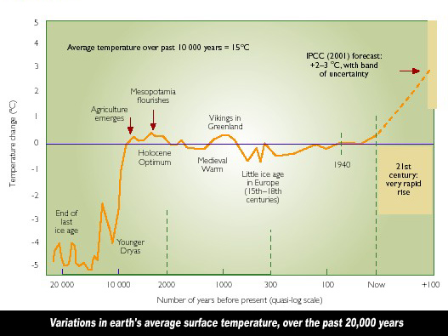

Slide 19
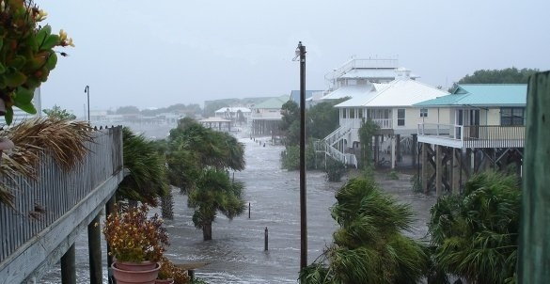
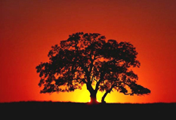
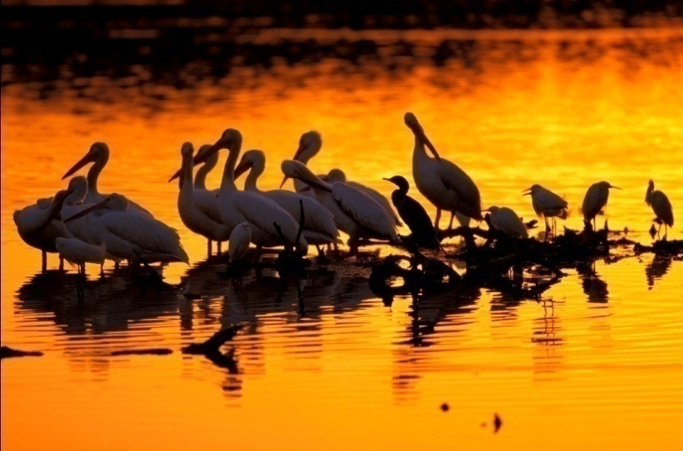

Effects of Global Warming
Rising Sea Level
Increased Temperature
Habitat Damage and
Species Affected
Changes in Water Supply

Slide 20
Effects of Global Warming
Drastic Changes in Climate Patterns
Global warming will alter the climatic patterns of the planet. As far as precipitation is concerned, it will increase in equatorial, polar and sub-polar regions, and decrease in subtropics. This change in precipitation pattern will trigger a drought in some regions, while floods in other regions.
Warming of the atmosphere will increase the temperature of ocean waters, which will continue being warm for a few centuries. Warm water will lead to frequent natural disasters like hurricanes.
Overall, the planet will experience extreme weather conditions, characterized by flood and droughts, heat waves and cold waves, and extreme storms like cyclones and tornadoes.

Slide 21
Effects of Global Warming……
Widespread Extinction of Flora and Fauna
A rise in global temperature will also hamper the rich biodiversity of various ecosystems.
According to the Intergovernmental Panel (IPCC), an increase in global temperature by 1.5 to 2.5 degrees will make 20 to 30 percent of species vulnerable to extinction, while a rise of about 3.5 degrees will make 40 to 70 percent species vulnerable to extinction.
Climate change will result in loss of habitat for many animal species like polar bears and tropical frogs. More importantly, any change in the climate patterns will seriously affect the migration patterns of various bird species.
Irregular patterns of precipitation will affect animals and humans alike.

Slide 22
Effects of Global Warming……
Changes in the Global Sea Level
Over the last century, sea levels have increased by 4 to 8 inches, and by 2100, it's expected to increase to 35 inches. An additional 2 degree rise in global temperature will lead to the complete melting of the Greenland ice cap, which will cause the sea level to rise by 5 to 6 meters.
Such a rise will cause many of the low lying areas, such as the US Gulf Coast and Bangladesh, to submerge underwater. If the whole of the Antarctic ice sheet melts, the global sea level is expected to rise by 10.5 meters.

Slide 23
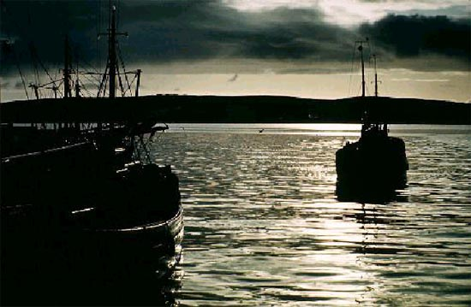
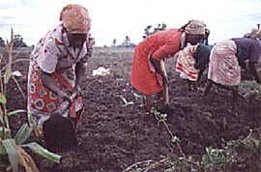
Food production needs to double to meet the needs of an additional 3 billion people in the next 30 years.
Climate change is projected to decrease agricultural productivity in the tropics and sub-tropics for almost any amount of warming.
Many people will die of malnutrition as food production will decrease due to frequent droughts and floods.

Slide 24
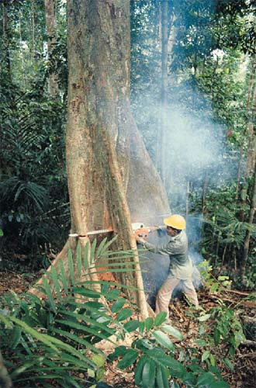
Biomass is the only source of fuel for one third of the world’s population.
Wood demand will double in the next 50 years.
Forest management will become more difficult due to an increase in pests and fires.

Slide 25
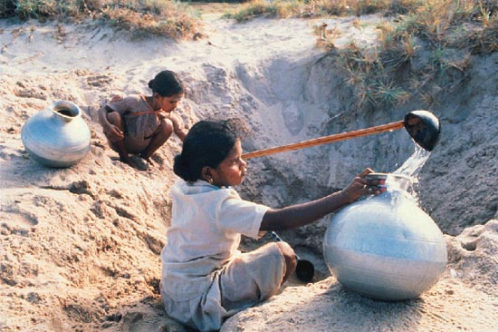
Climate change is projected to decrease water availability in many arid- and semi-arid regions
Population facing water scarcity will be more than double over the next 30 years
One third of the world’s population is now subject to water scarcity

Slide 26
Map showing different SLR scenarios to estimate how much salt water will intrude inland
Rising sea levels in the Bay of Bengal encroaching inland in the southern districts of Bangladesh - resulting in salinization
In the last 50 years, salinity has risen by 45%
20 million people currently affected to variation in climatic conditions

Slide 27
Possible Impacts of climate change in Bangladesh
Human Health impacts
Increase of vector born diseases
Ecosystem Impacts
Coastal wetland loss from sea level rise
Increase of salinity
Agriculture Impacts
Adverse effect on wheat, potato, Boro yield
Loss of agricultural lands
Water Resources Impacts
Increase of drought, intensity of flood and cyclone
Energy Impacts
Increase energy demand in winter for heating and summer for cooling

Slide 28
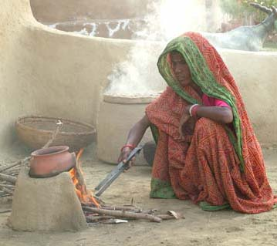
The impact on women
Women suffer disproportionately more during disasters
70% of world’s poor are women
Women account for the majority of climate-related deaths
Biological vulnerabilities:
Nutrition
Reproductive health
Social vulnerabilities:
Poverty
Discrimination
Sexual violence
Need for international climate policies to be gender sensitive.

Slide 29
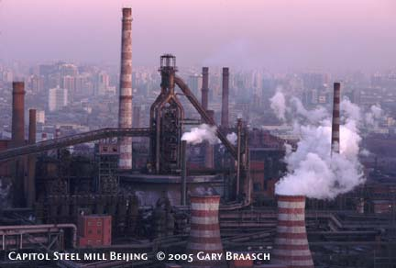
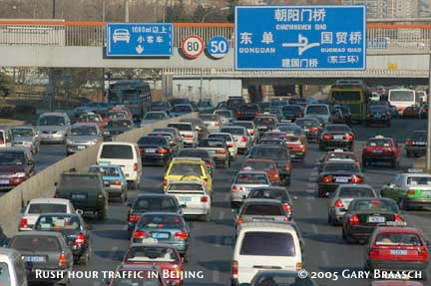
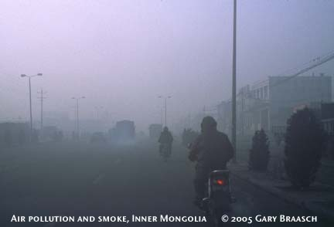
The Worlds Greatest Challenge?
Every year China builds 60 gigawatts of power-generation capacity, almost as much as Britain's entire existing capacity.
Four-fifths of Chinese power is generated by coal, the dirtiest source of electricity.
China currently uses 40% of the world's coal—more than America, Europe and Japan put together.

Slide 30
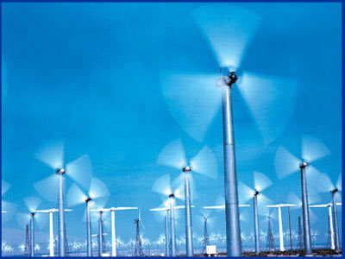
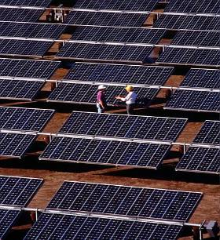
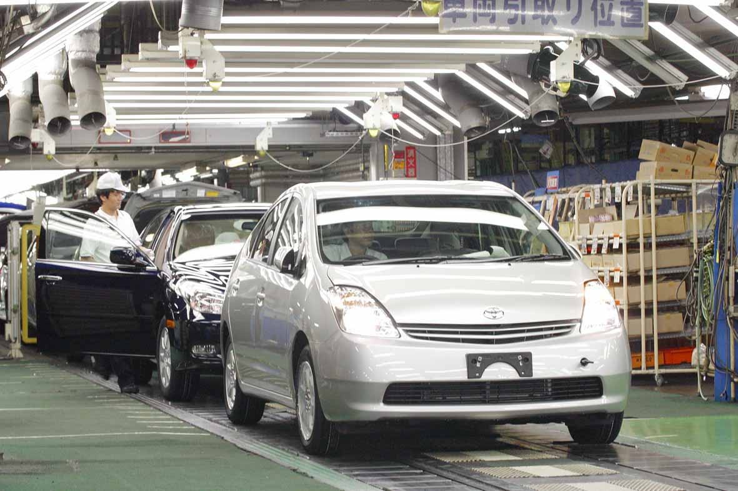
What’s being done now to reduce our emissions?
Wind Power
Solar Power
Fuel-Efficiency

Slide 31

Simple Things To Do
Turn off your computer or the TV
when you’re not using it.
Take shorter showers. Heating water uses energy.
Keep rooms cool by closing the blinds, shades, or
curtains.
Turn off the lights when you leave a room.
Use compact fluorescent bulbs.

Slide 32

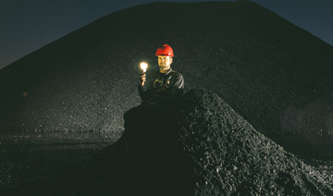
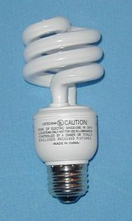
Be Bulb Smart—Use CFLs
What’s the difference?
Compact
Fluorescent
Incandescent
500 lbs. of coal
1,430 lbs. CO₂ pollution avoided
$30 saved

Slide 33
Concluding Remarks
Many people argue that global warming is a slow process, and will take centuries for all of these devastating effects to take place. But they forget that the factors which cause global warming are rapidly rising.
We have already done enough of damage, and hence it's high time we understand the global warming causes, effects and the future repercussions and work out some global warming solutions at the earliest.
We may not live to face the dreaded consequences of global warming, but if we don't act fast, it will be our future generations who will have to bear the brunt.

Slide 34
Concluding Remarks……
Warming of 2°C threatens many tens of millions with increased risk of hunger, hundreds of millions with increased Malaria risk, millions with increased flooding and billions with risk of water shortage.
All these threats most severe for developing countries and poor people everywhere
Warming of 2°C risks major ice sheet responses with commitments to many metres of sea level rise.
Ensuing sea level rise threatens large populations everywhere and particularly in developing countries
Warming of 2°C threatens major ecosystems from the Arctic and Antarctic to the tropics
Loss of forests and species will affect the lives of all with economic costs falling disproportionately on the poor and developing countries
Avoiding 2°C warming is going to be very difficult now, but not impossible!

